Slide 1
Hierarchical Agglomerative Cluster
HAC
https://www.datavedas.com/hierarchical-clustering/

Slide 2
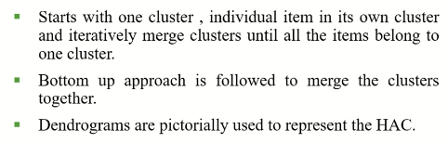
Bottom Up Clustering (HAC)

Slide 3
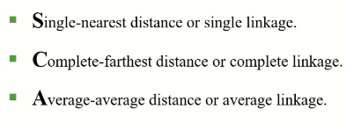
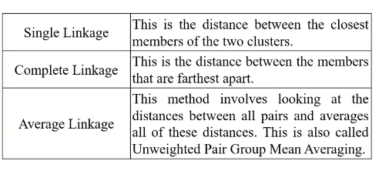
Measures of Similarity

Slide 4
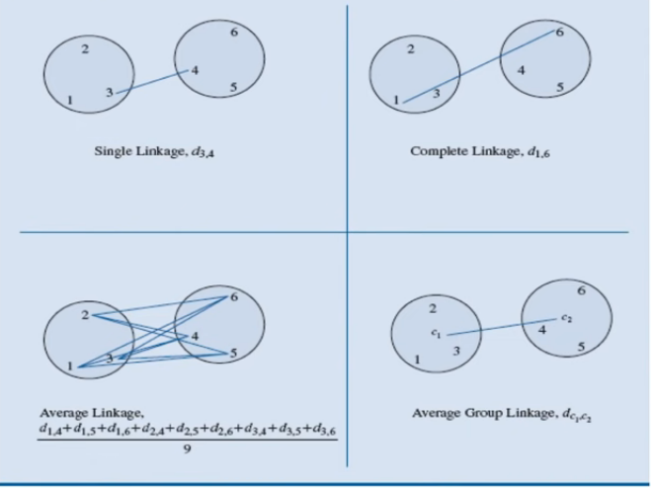
Measuring the Similarity

Slide 5
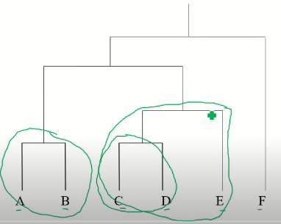
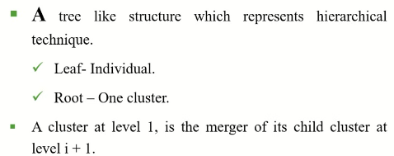

Slide 6
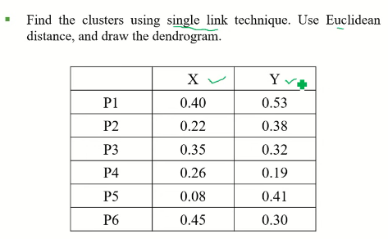

Slide 7
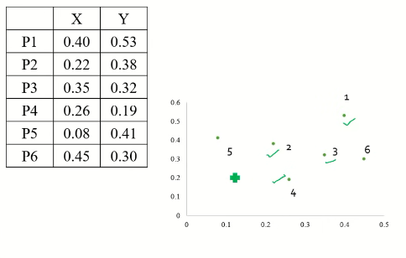

Slide 8
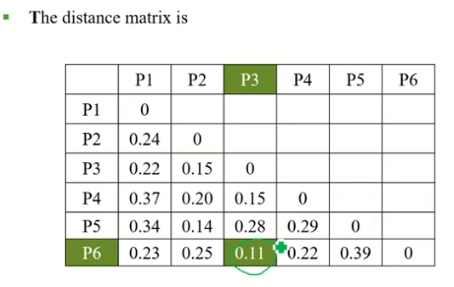

Slide 9
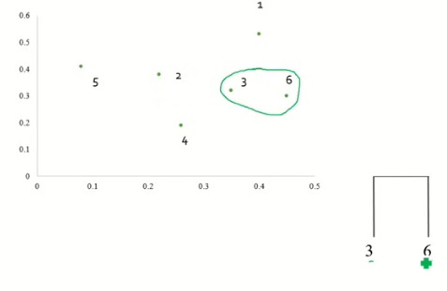

Slide 10
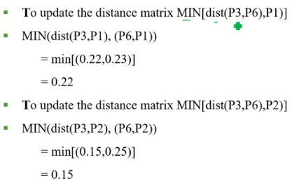

Slide 11
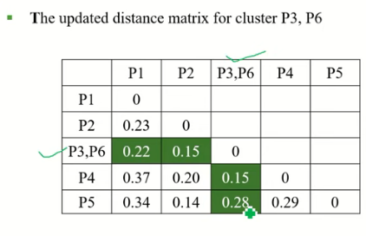

Slide 12
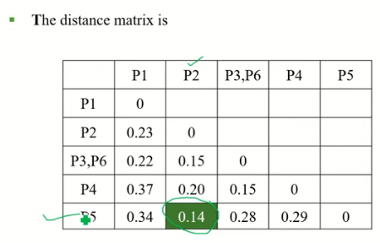

Slide 13
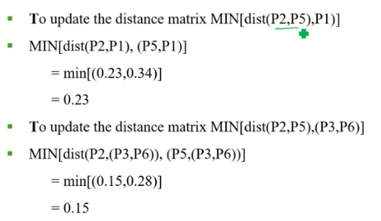

Slide 14
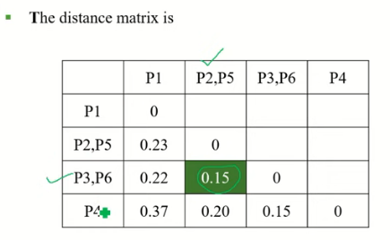

Slide 15
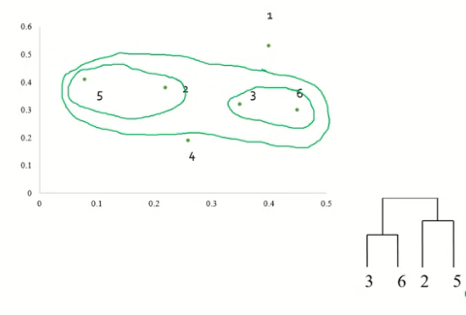

Slide 16
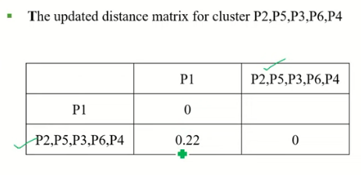

Slide 17
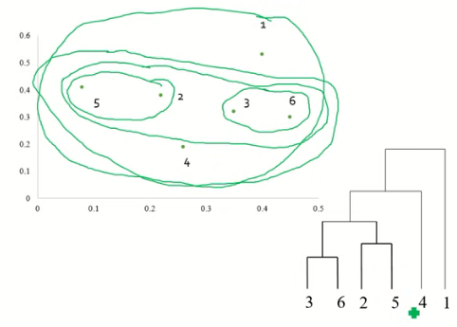

Slide 19
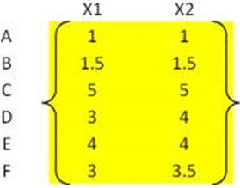
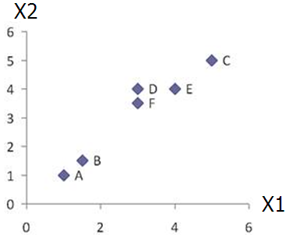
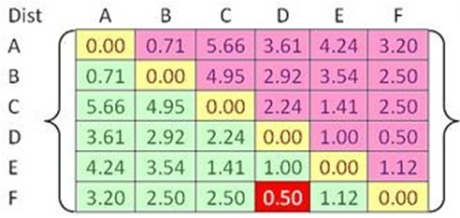


Example
Problem: clustering analysis with agglomerative algorithm
data matrix
Euclidean distance
distance matrix

Slide 20
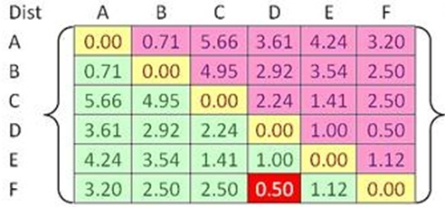
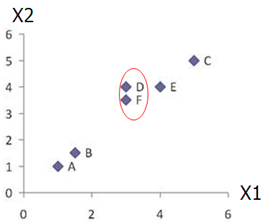
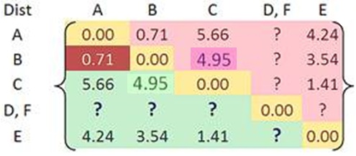

Merge two closest clusters (iteration 1)

Slide 21
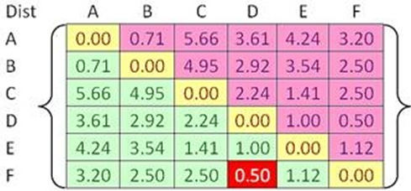

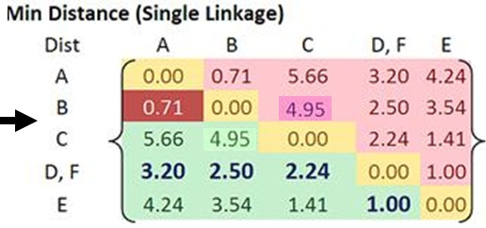
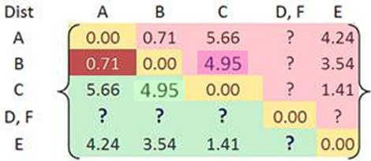
Update distance matrix (iteration 1)

Slide 22
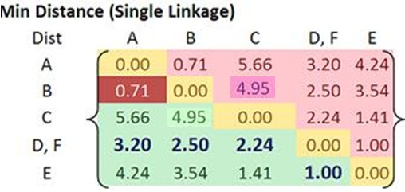
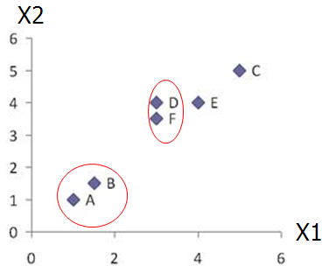
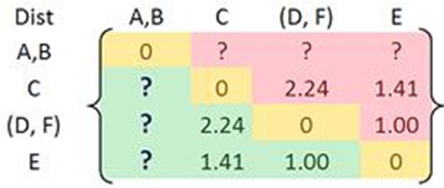
Merge two closest clusters (iteration 2)

Slide 23
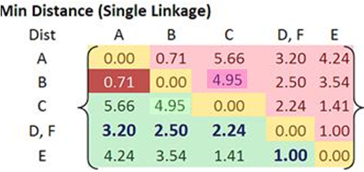
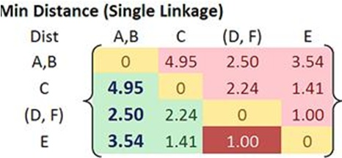

Update distance matrix (iteration 2)

Slide 24
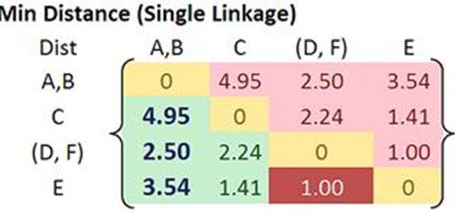
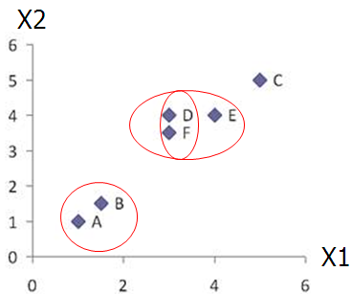
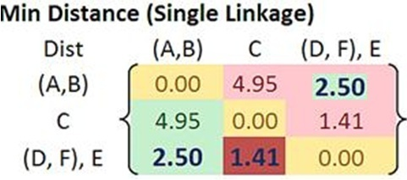

Merge two closest clusters/update distance matrix (iteration 3)

Slide 25
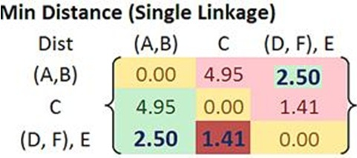
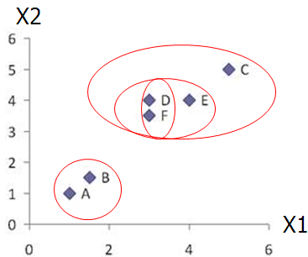
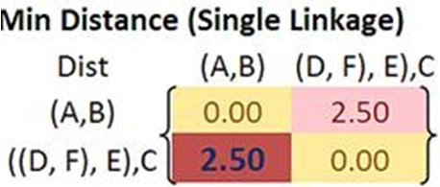

Merge two closest clusters/update distance matrix (iteration 4)

Slide 26
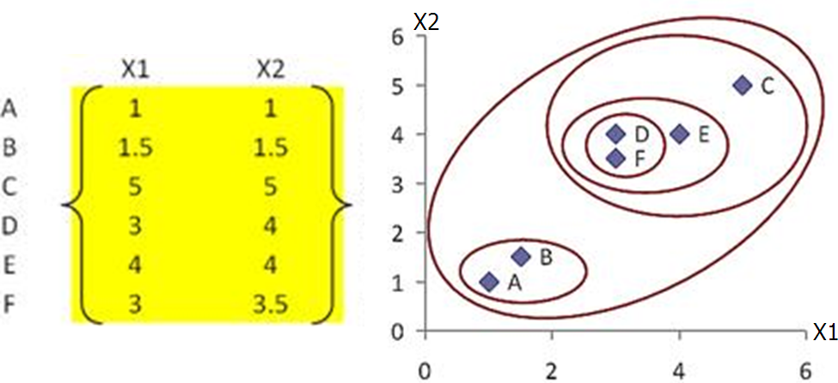
Final result (meeting termination condition)

Slide 27
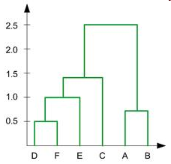
Example
Dendrogram tree representation
In the beginning we have 6
clusters: A, B, C, D, E and F
We merge clusters D and F into
cluster (D, F) at distance 0.50
We merge cluster A and cluster B
into (A, B) at distance 0.71
We merge clusters E and (D, F)
into ((D, F), E) at distance 1.00
We merge clusters ((D, F), E) and C
into (((D, F), E), C) at distance 1.41
We merge clusters (((D, F), E), C)
and (A, B) into ((((D, F), E), C), (A, B))
at distance 2.50
The last cluster contain all the objects,
thus conclude the computation
6
lifetime
5
4
3
2
object
Notes:
For a dendrogram tree, its horizontal axis indexes all objects in a given data set, while its vertical axis expresses the lifetime of all possible cluster formation.
The lifetime of a cluster in the dendrogram is defined as a distance interval from the moment that the cluster is created to the moment that it disappears by merging with other clusters.

Slide 28
Hierarchical: AGNES & DIANA

Slide 29
Contd….
Two types of Hierarchical Clustering: Agglomerative (bottom-up) and Divisive (top-down).
Agglomerative (AGNES): begin with each element as a separate cluster and merge them into successively larger clusters
Divisive (DIANA): begin with the whole set and proceed to divide it into successively smaller clusters.
Notes:
Probably the simplest clustering technique – very straightforward.

Slide 30
Contd….
Step 0
Step 1
Step 2
Step 3
Step 4
agglomerative
(AGNES)
a
a b
b
a b c d e
c
c d e
d
d e
e
divisive
(DIANA)
Step 4
Step 3
Step 2
Step 1
Step 0

Slide 31
AGNES (Agglomerative Nesting)
Agglomerative, Bottom-up approach
Initially each item in its own cluster
Iteratively clusters are merged together

Slide 32
DIANA (Divisive Analysis)
Initially all items in one cluster
Large clusters are successively divided
Top Down

